Slide 1

Travel Management System
Presented By
Monisha Gowrisankar
EBEON1021437
2021-6141

Slide 2



CONTENTS
Introduction
Problem Statement
Features
Advantages
Requirements
Output
Conclusion

Slide 3
INTRODUCTION
The Project Travel Management System Software is for the Customers to rent vehicles.
So this way makes their renting more simpler and Stores all their data in the Database.
MySQL is used to Manage the Database.

Slide 4
Problem statement
The Travel Management System helps the Customers to makes their renting of vehicles more easier.
Adding the Customers details.
Updating the details of the Customer.
Deleting the Customer Details.
Search particular details of the Customers.
Viewing all the details from the Database.

Slide 5
Features
In Travel Management The Customers Can,
View the Vehicles List.
Select their Vehicles by simply selecting and providing information from the List displayed.
Update their details.
Also Delete the details they provided.

Slide 6
Advantages
Manage the Information of customer details.
Can book anywhere at anytime.
User Friendly.
Easy to use and understand.

Slide 7
System Requirements
Operating System : Windows 10
Technology : Core Java, adv Java(JDBC)
Development Environment : Eclipse
Database :MySQL
Software : jdk 1.8.0_202, jre 1.8.0_202

Slide 8
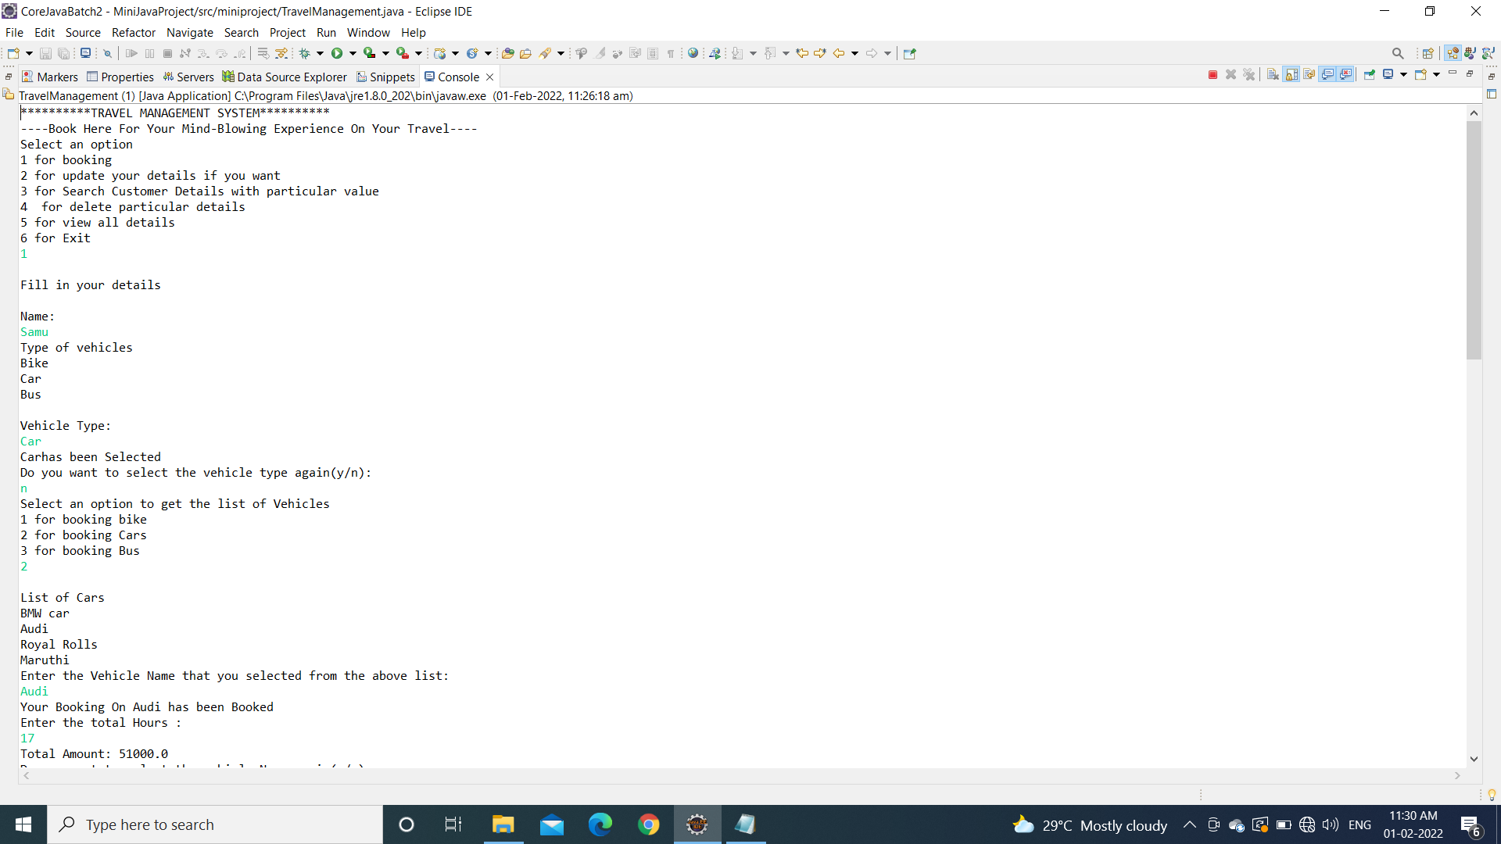
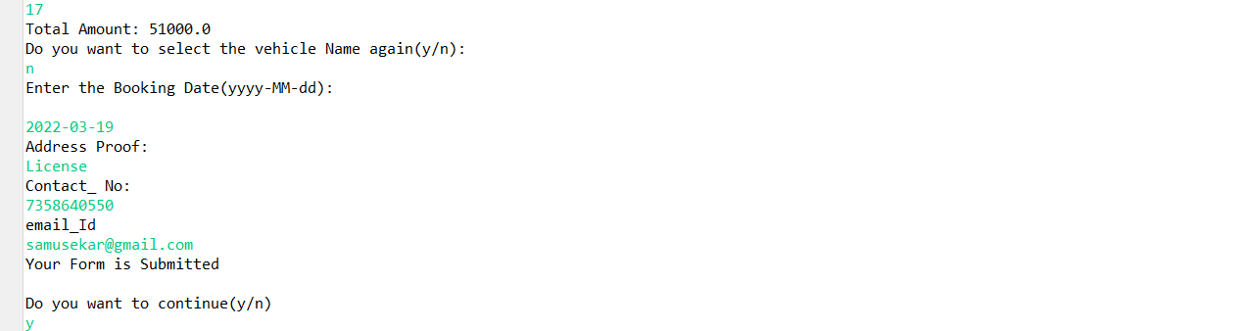
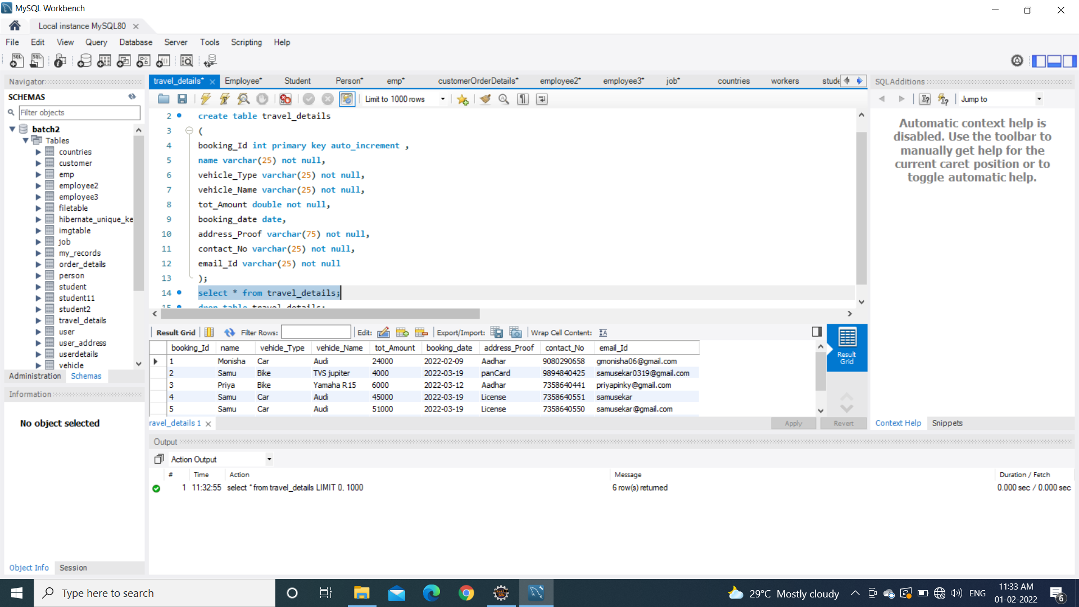
Output

Slide 9
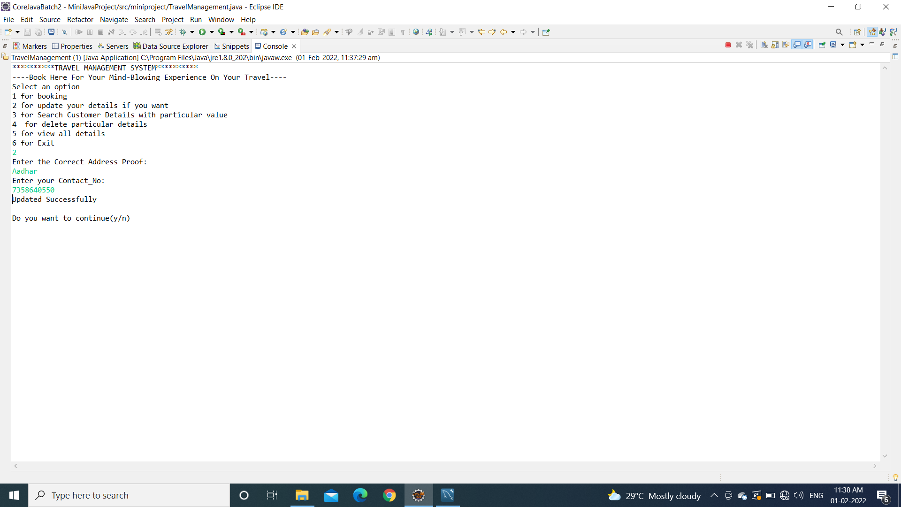
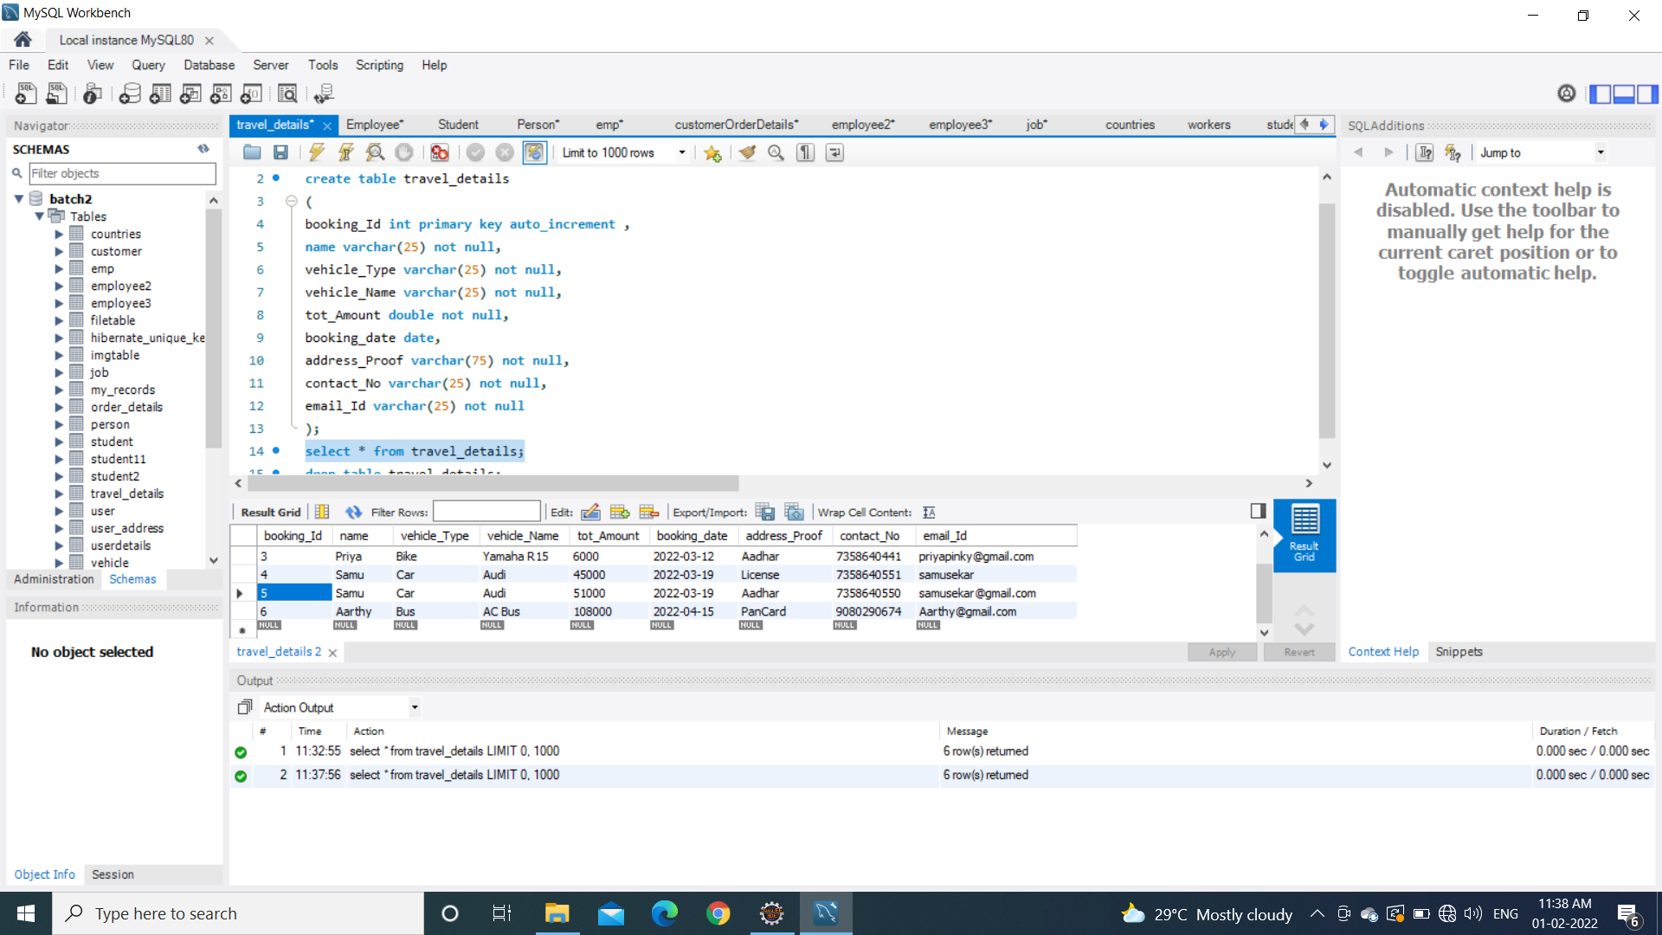

Slide 10



Slide 11

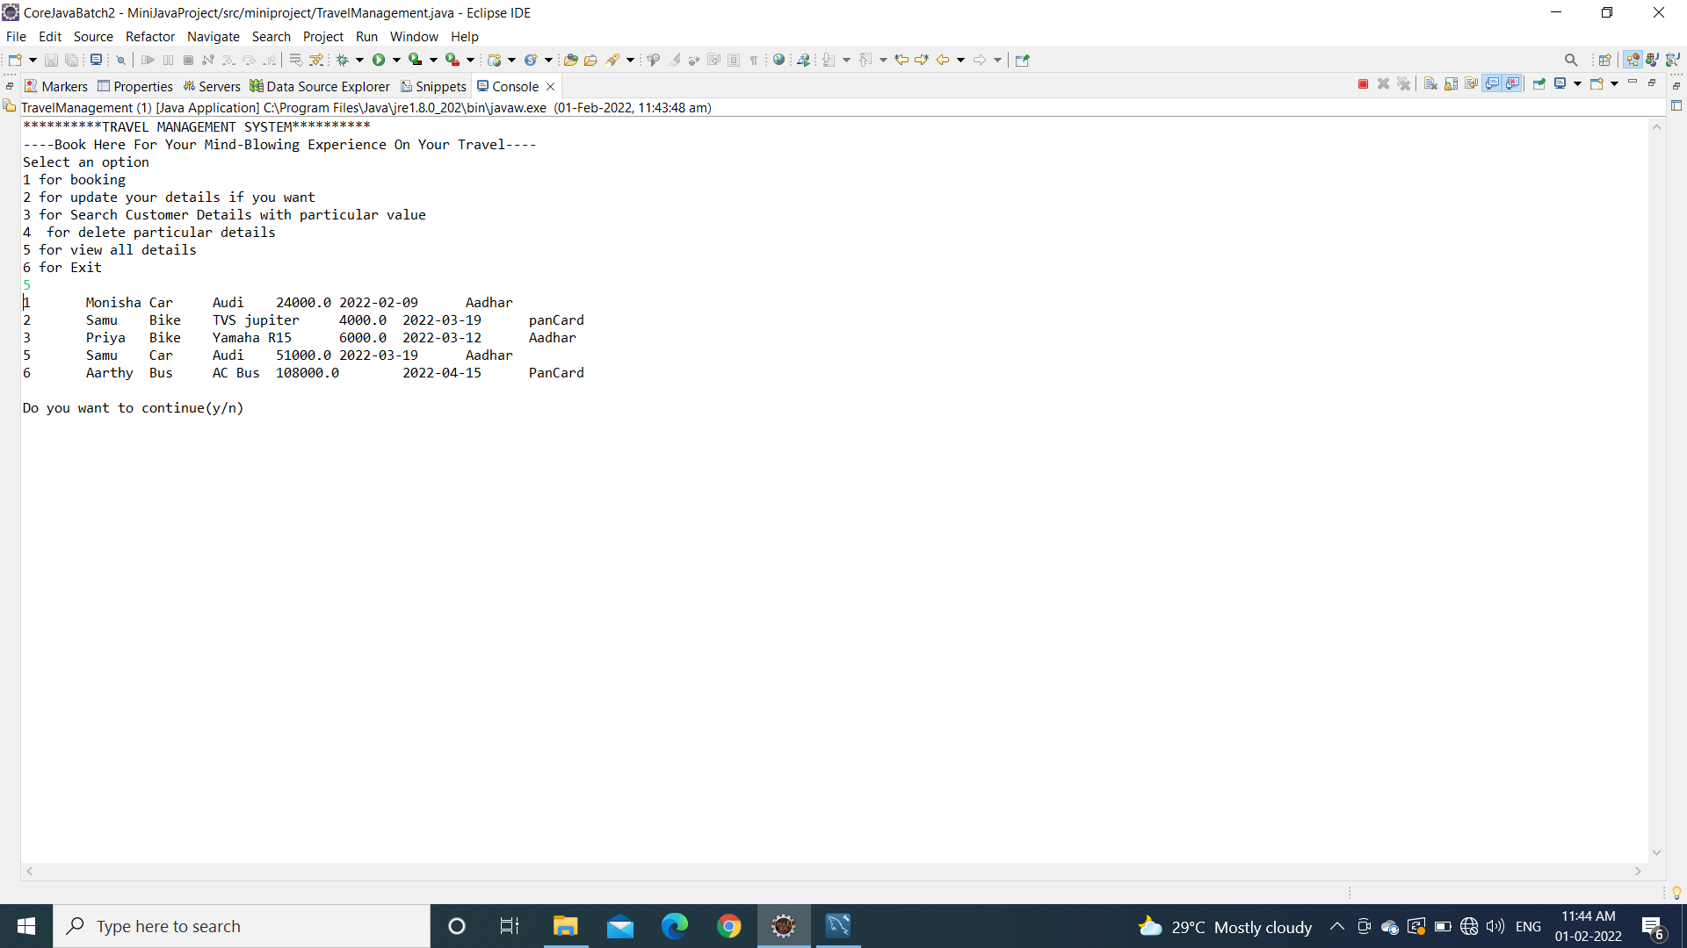
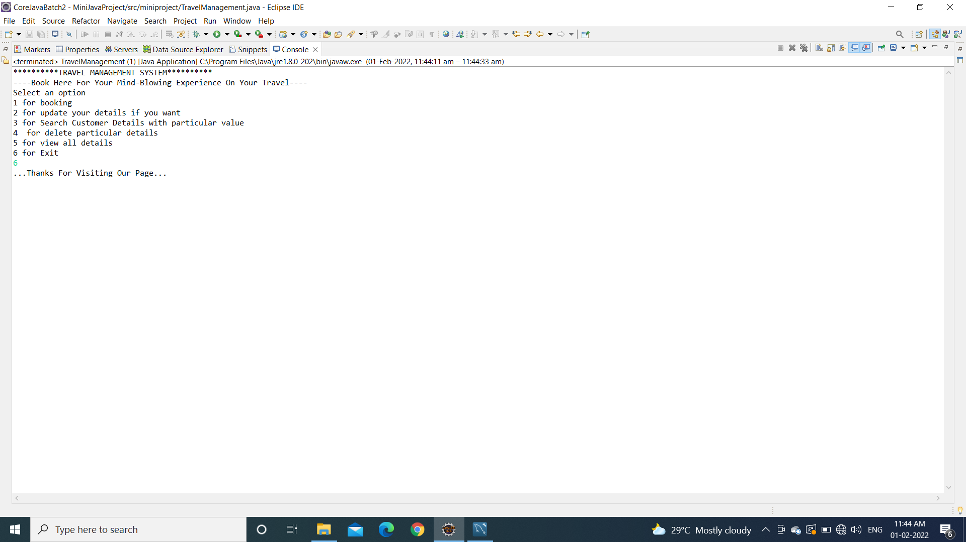

Slide 12
Conclusion
We can store the Customer details for future purpose using Database and can save the time of the Customers for Renting the vehicles within a short span of time in more simpler form.

Slide 13


